Slide 1
DIGITAL PORTFOLIO
STUDENT NAME: Janci rani J
REGISTER NO AND NMID:24131130500122006
/asanm11324131130500122006
DEPARTMANT: BCA – II year
COLLEGE NAME AND UNIVERSITY: 113-VALLALAR ARTS AND SCIENCE COLLEGE,ANNAMALAI UNIVERSITY

Slide 2
PROJECT TITLE:
WEB DESIGNER
PORTFOLIO

Slide 3
AGENDA:
1.Problem Statement
2.Project Overview
3.End Users
4.Tools and Technologies
5.Portfolio design and Layout
6.Features and Functionality
7.Results and Screenshots
8.Conclusion
9.Github Link

Slide 4
PROBLEM STATEMENT:
Customer service skills and achievements are often hard to showcase through a traditional resume. Professionals need an interactive portfolio to highlight communication abilities, support metrics, and tools used. This project solves that by creating a digital portfolio using HTML, CSS, and JavaScript.

Slide 5
PROJECT OVERVIEW:
Designed a professional portfolio website for a Customer Service Representative.
Showcases key skills, achievements, and customer support metrics.
Built using HTML, CSS, and JavaScript for interactive design.

Slide 6
END USERS:
Hiring managers looking to evaluate customer service skills.
Recruiters searching for candidates with proven support experience.

Slide 7
TOOLS AND TECHNIQUES:
HTML5 – for structuring portfolio content.
CSS3 – for styling and responsive design.
JavaScript – for interactivity and form validation.

Slide 8
PORTFOLIO DESIGN AND LAYOUT:
Modern and professional UI with dark theme and brand colors.
Responsive grid layout for About, Skills, Projects, and Contact sections.
Hero section with portrait and key highlights in cards.

Slide 9
FEATURES AND FUNCTIONALITY:
Interactive navigation with smooth scrolling across sections.
Hero section showcasing key metrics like CSAT, FCR, and response time.
Skills and projects displayed with filtering and highlights.

Slide 10
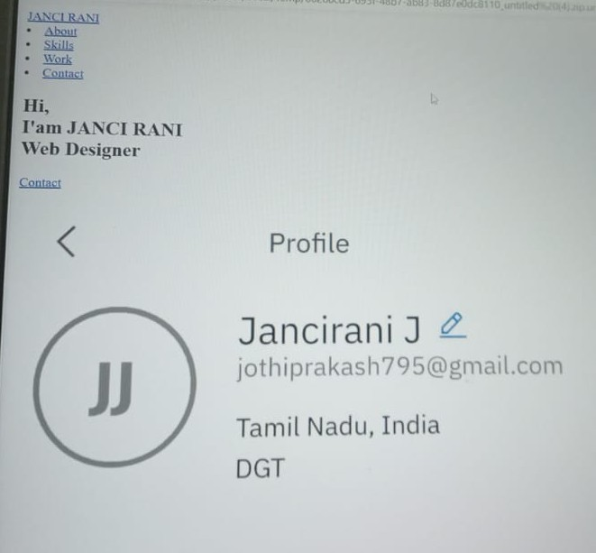
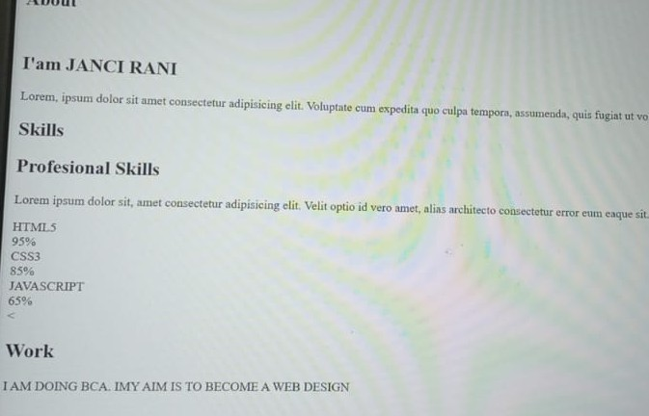
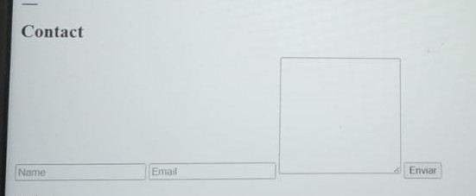
RESULTS AND SCREENSHORT:

Slide 11
CONCLUSION:
This portfolio demonstrates how customer service expertise can be presented in a modern and engaging way.
It highlights key skills, metrics, and achievements with interactive features.

